Slide 1
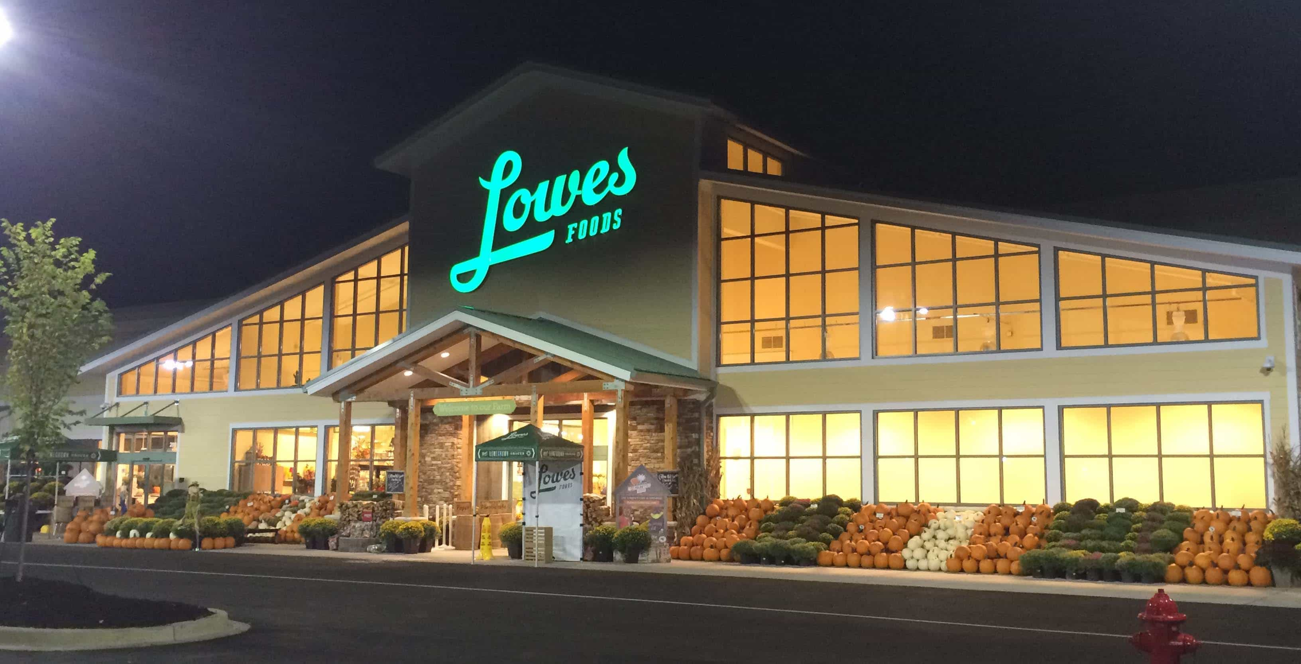
LOWES FOODS
Notes:
Lowes Foods is a renowned chain of supermarket that is based in North Carolina. Its shoppers are able to order goods such as groceries and then pick them up at their stores. It also introduced home deliveries in South and North Carolina.

Slide 2
INTRODUCTION
Sell of substandard and expired goods to its customers
Notes:
In 2011, many of its customers complained of substandard goods and expired items that were being sold at the supermarket. The management confirmed the allegations and promised to take a course of action to its suppliers.

Slide 3
OBJECTIVES BEFORE CRISIS
Expanded in North and South Carolina
https://www.youtube.com/watch?v=5Ci-b8xH6G8
Offered high quality goods and services
https://www.youtube.com/watch?v=Dl1Ftt7IQ9M
Notes:
Lowes food was a leading supermarket that had expanded in metropolitan regions of North and South Carolina.
The supermarket was known for quality goods and services, its customers were always assured of getting the high quality goods in the market.

Slide 4
OBJECTIVE AFTER CRISIS
Loss of its customers
Negatively affected the supermarket’s operations
Notes:
Lowes food’s lost nearly half of its customers who opted to shop in other supermarkets.
The operations were heavily affected due to the loss of customers which resulted into losses.

Slide 5
SOLUTION
Investigate the whole issue in details
Compensate the affected customers
Notes:
The first of all is to investigate the whole issue of selling expired items before blaming its suppliers.
The second solution would be to retain its customers by compensating those that purchased expired goods.

Slide 6
CONCLUSION
Make an assurance to its customers through an apology
Notes:
In conclusion following the enactment of the suggested changes, Lowes foods will:
Regain back its customer’s confidence and retain its value by apologizing and ensuring that such cases will never occur in future.

